Slide 1




FASTER
FREEDOM
FORMULA
SuperDave

Slide 2
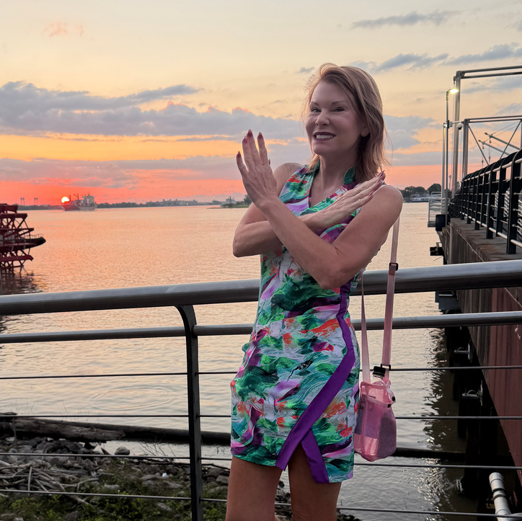
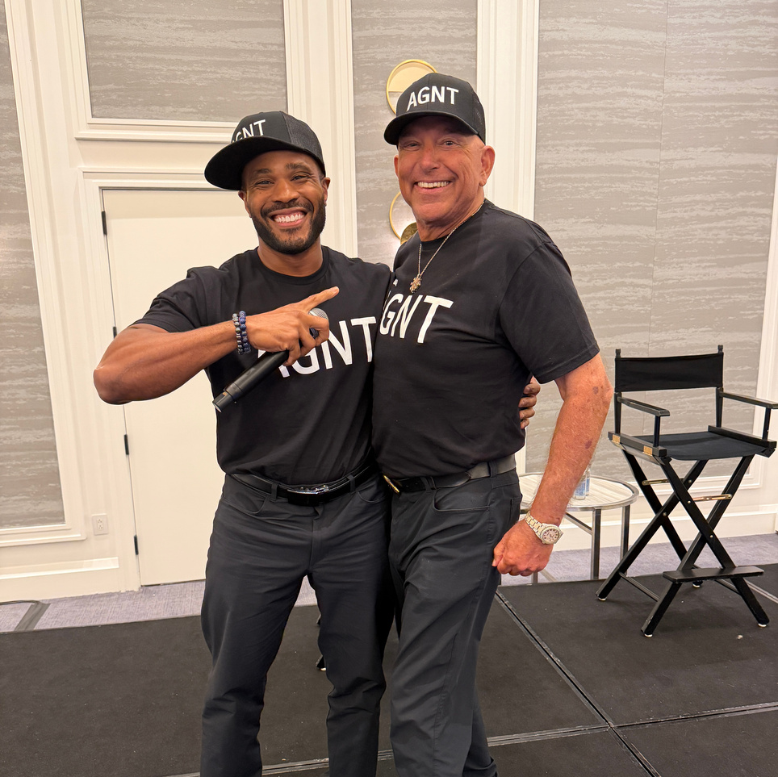
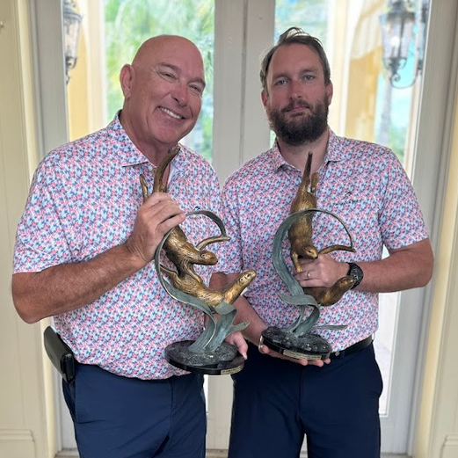
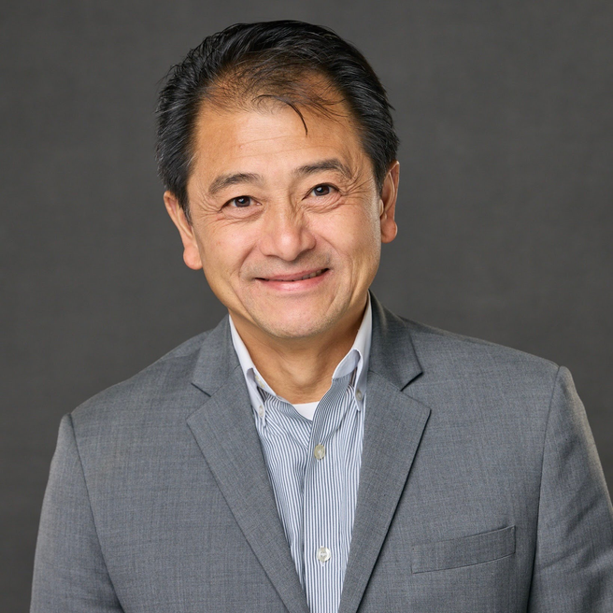
SuperDave
MEET YOUR PRESENTERS
TRACI GAGNON
DAVE GAGNON
NATE GAGNON
TOM TRUONG

Slide 3

Traci

Slide 4
THE SHIFT
The old model:
The new model:
“How many agents can we recruit?”
“How many productive leaders can we help create?”
A new model for real estate leadership — one that rewards the builders of productive, sustainable organizations. The industry is moving from attraction to contribution.
Leadership. Mentorship. Retention. Productivity. Culture.
Tom

Slide 5
WHY THIS MATTERS?
The old model is wearing thin
Agents are tired of hearing recruit, recruit, recruit. That singular focus creates burnout, instability, and a ceiling on what organizations can become.
The new standard
This shift creates a more mature, sustainable growth model — one where leadership and organizational health are the real measures of success. Not headcount. Impact.
Tom

Slide 6




What eXp is Rewarding
The metrics that matter most are the ones that build lasting organizations.
Retention
Growth Per Person
Productivity
Keeping great agents engaged and growing.
Depth of development, not just breadth of recruitment.
Real output and transaction performance.
Event Participation
Training & Contribution
Showing up, contributing, and leading in person.
Investing in others and the broader community.
Tom

Slide 7
The Big Opportunity
A Rare Achievement
Very few agents will ever build organizations at this level. But the existence of this opportunity changes what agents believe is possible — and that belief is transformational.
The Legacy Conversation
This opens a real, long-term conversation about wealth creation and legacy — not just commission checks, but something that endures and compounds over time.
Tom

Slide 8
WHY LEADERS WILL PAY ATTENTION
Top Producers
Independent Brokers
Contributing Leaders
High-performing agents want more than just another split. They want recognition for the organizations they've built and the leaders they've become.
Brokers seeking enterprise value and stability are looking for a platform that rewards long-term commitment, not just short-term volume.
This model rewards people who keep showing up — mentoring, training, and leading — not just those who recruit once and move on.
Tom

Slide 9
COMPETITIVE POSITIONING
The industry is shifting and eXp is positioned to lead.
1
Industry Shift
The broader market is moving toward legacy and leadership models. Agents and brokers are demanding more than transactional relationships.
2
eXp Leads
eXp now has the opportunity to own that conversation — setting the standard for what modern real estate leadership looks like.
3
Long-Term Value
This strengthens the company's value proposition for years to come, attracting the leaders who will define the next era.
Tom

Slide 10
Group Builder Status
The Legacy 500
Recognition for agents and leaders building impactful, collaborative organizations — and contributing to the broader eXp ecosystem through attraction, education, events, and leadership.
GROUP BUILDER STATUS
The Legacy 500
LEGACY LEADER
LEGACY PINNACLE
LEGACY BUILDER
LEGACY PARTNER
7 TIERS
LEGACY VISIONARY
10
50
200
500
1000
agents
agents
agents
agents
agents
SuperDave

Slide 11
Legacy Pinnacle Award
Unlock 7 Revenue Share Tiers with the Following Qualifications
ACTIVE AGENTS IN YOUR ORGANIZATION
TOTAL POINTS EARNED WITHIN 12 MONTHS
500
40
20 Impact Points
20 Event Points
  In-person attraction event 5+
  Virtual attraction event 3+
  In-person training event 5+
  Virtual training event 3+
  eXpcon 5+
  Regional Rally 5+
  Top Agent Mastermind 5+
*At least half of your Impact Points must come from events with/for another organization.
Org productivity requirement must be met (% of agents in your organization completing 3+ transactions) and organization must stay above 500 agents.
Group partners must meet with Amy Weaver/Susan McClain every quarter to review org growth, retention, and productivity.
SuperDave

Slide 12

Have 500 in your Orginization?Apply NOW!
https://legacy-pinnacle.lovable.app
What happens next: Once we receive your application, Abby Nussbaum will reach out to you directly to set up your strategy and review meeting with Susan and Amy!
SuperDave

Slide 13



FastCAP
STARTS TODAY AT 2 PM ET!
During First Full Cohort: FastCappers who completed the minimum recommended daily “Real Talks” (customer conversations) averaged in just 6 weeks:
— 6.9 appointments per person (buy & list)
— 3.8 agreements per person (buy & list)
Nate
REGISTER HERE

Slide 14

What’s new in FastCAP?
More tools. More leads. More accountability — for agents who commit.
U.S. FASTCAPPERS
CANADIAN FASTCAPPERS
  Access to Realty.com Seller Pro Package
  Buyer & seller cultivation tools + live leads
  Pilot results (5 weeks):
  1,513 leads delivered to 362 FastCAPpers
  90%+ listing leads
  No upfront fees. No referral fees
  ZooCasa ISA-scrubbed leads
  HonestDoor seller cultivation tool
  Referral fees apply:
  25% ZooCasa leads
  45% Partner leads
FINISH FASTCAP.
KEEP THE ADVANTAGE.
Agents who complete FastCAP and do the work receive continued access to these tools and leads for up to 12 months total.
Nate
REGISTER HERE

Slide 15

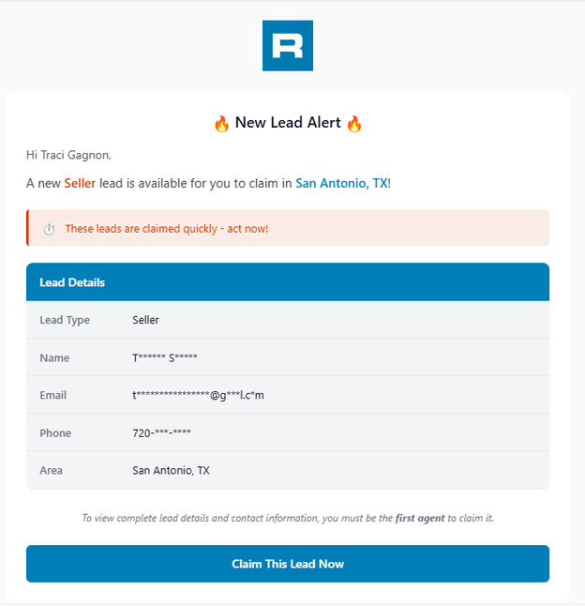
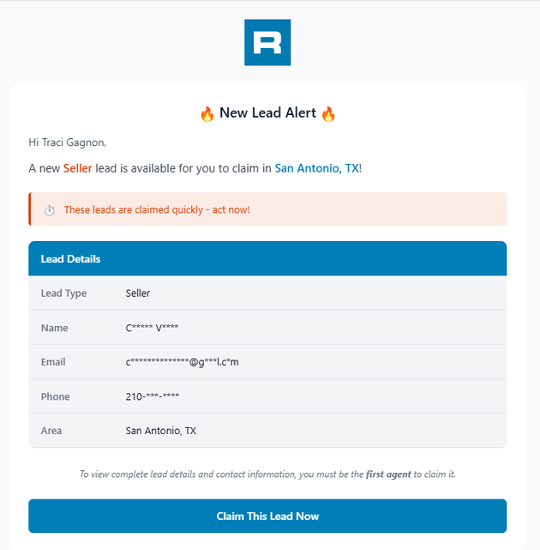
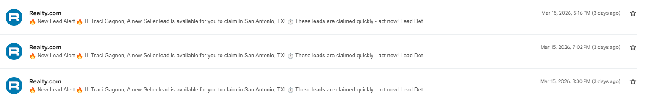
Nate
FINISH FASTCAP.
KEEP THE ADVANTAGE.
Agents who complete FastCAP and do the work receive continued access to these tools and leads for up to 12 months total.

Slide 16


FASTATTRACT
NEXT COHORT STARTS JULY 17TH
Agents who complete FastATTRACT will walk away with:
  A daily attraction rhythm that fits their unique strengths
  Systems and tools to track and scale their growth
  A confident, compelling value story
  And a growing pipeline of agents ready to partner
Nate

Slide 17


TEAM LEADER ACADEMY
Build a scalable, profitable, agent-centric organization.
Early Bird Tuition: $2,000 USD
(REGULAR PRICE: $2,500 USD)
September 3–15, 2026 LIVE ZOOM TRAINING
ENROLL HERE

Slide 18

THE 200 CLUB
The eXp Realty "200 Club" is an exclusive, ongoing mastermind and growth challenge for agents and leaders building their organizations. Its primary mission is to help dedicated professionals scale their recruitment and leadership skills to hit the 200-agent mark in their downline.
How to Get Involved:
To access these mastermind sessions, leaderboards, and direct support from eXp's regional Growth Vice Presidents:
  Ensure you meet the baseline requirements (1+ agents in your network or FastATTRACT completion).
  Keep an eye on your official Slack channels and company emails for direct invites.
  Contact your local growth leader or eXp sponsor directly to get the registration link.
Classes happen every first and third Tuesdays, at 1:00 PM ET
meet.google.com/owm-otvr-jvv
Tom

Slide 19

GROWTH & ATTRACTION TOOLKIT
Everything you need to grow smarter at eXp
Inside the Toolkit
Designed For
✔ Attraction & recruiting resources
✔ Sponsor/prospect call booking tools
✔ Presentation decks & shareables
✔ Event & growth materials
✔ Scripts & conversation guides
✔ Retention & onboarding support
✔ Growth leadership resources
✔ AI & communication tools
  Team Leaders
  Sponsors
  Growth-Focused Agents
  Builders Scaling Their Organization
https://exptoolkit.ca/growth
ONE CENTRAL HUB FOR:
Attraction • Retention • Community • Growth
Tom

Slide 20

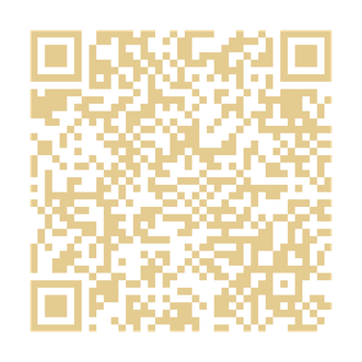
Nate
JULY 15- JULY 17, 2026
REGISTER HERE

Slide 21
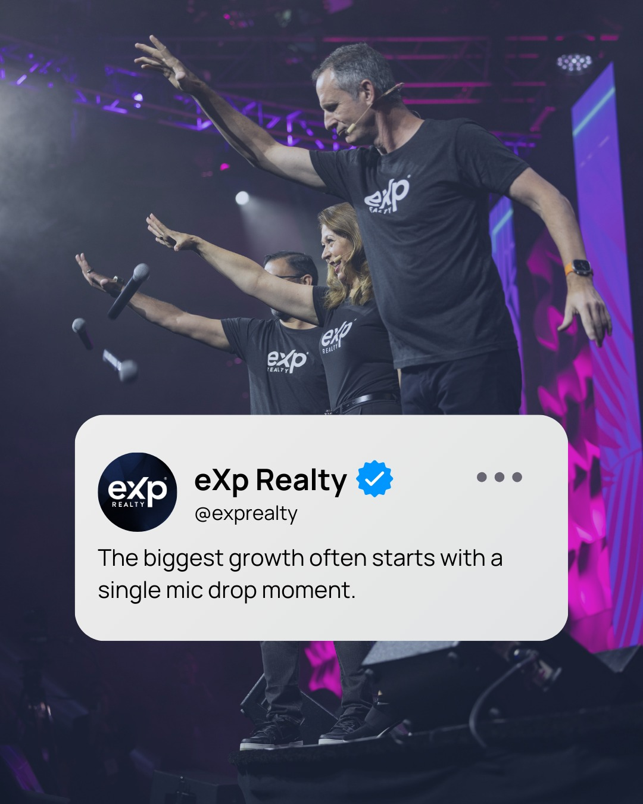


OCTOBER 7 - OCTOBER 9, 2026
EXPCON IS THE MOST POWERFUL EVENT IN OUR ECOSYSTEM. NON-NEGOTIABLE FOR SERIOUS GROWTH.
REGISTER HERE
Nate

Slide 22


APRIL 18 - APRIL 20, 2027
REGISTER HERE
Nate

Slide 23


Tom
Hosted by Gene and Susan Frederick & Brent and Kathy Gove
REGISTER HERE
APRIL 22-25 2027

Slide 24

Tom
Where agents and leaders come together to learn what’s working right now to grow faster, attract stronger agents, create momentum, and build organizations that last.
What You’ll Experience
The agents who stay plugged in… grow faster.
The leaders who stay connected… build bigger.
The people in the room always hear it first.
✔ Real growth conversations
✔ Leadership & attraction strategies
✔ Collaboration with high-level agents
✔ Systems that scale organizations
✔ Community-driven momentum
✔ Access to tools, resources & opportunities
Don’t Build Alone.
JOIN BUILD26 NORTHEAST

Slide 25
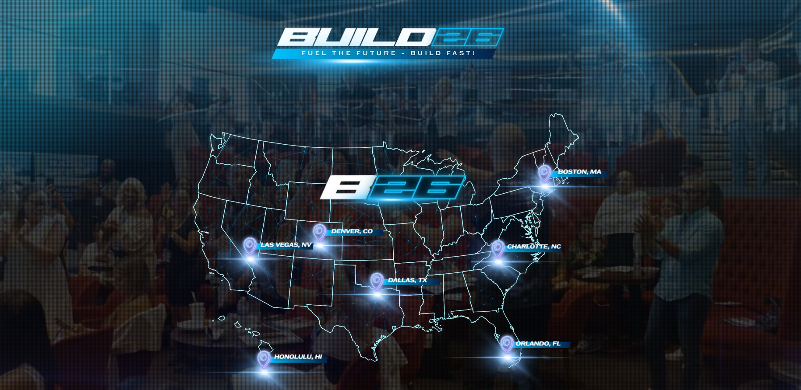

SEE ALL DATES HERE
Tom

Slide 26
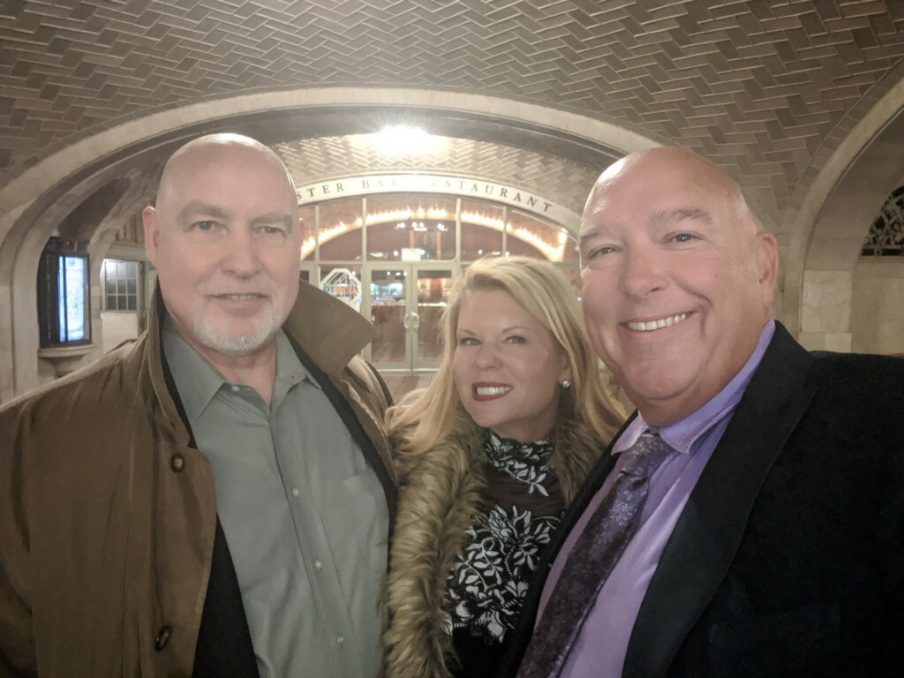
Randy
Randy Reis

Slide 27

REAL LIFE EXAMPLES
Ashley B
Han Q
ONE Conversation Changed Everything
It Was Never About Recruiting Hundreds
Recruited 1 agent total
Personally recruited 2 agents
Organization grew to 466 agents
Organization grew to 442 agents
Traci
This is what scalable growth looks like. Legacy growth compounds.

Slide 28




10 CAPPING AGENTS WHO SPONSOR 10 CAPPING AGENTS
TIER 1
10 CAPPING FRONT LINE AGENTS X $1,400 =
$14,000 + BONUSES
TIER 2
100 CAPPING FRONT LINE AGENTS X $1,600 =
$160,000 + BONUSES
CAN YOU IMAGINE HOW YOUR TEAM MIGHT GROW BEYOND THIS?
TOTAL: AT LEAST $174,000/YEAR IN PASSIVE INCOME!
PLUS
Traci

Slide 29
Jot down the names of:
  The top non-eXp agent in your market?
  The name of the last agent you did business with that you liked - or an agent that would recognize your name.
  Write down the name of an independent broker in your market, even if you don't know them personally.
Traci

Slide 30
FOR TOP-PRODUCING AGENTS:
eXp just made a major shift rewarding leadership, production, and long-term growth in a much bigger way. Thought of you immediately. Open to having our VP of Growth run your numbers to see what this could look like for you at eXp?
Traci

Slide 31
FOR AGENTS YOU’VE DONE DEALS WITH / RELATIONSHIP AGENTS:
One of the biggest changes eXp has made in years just rolled out around leadership and long-term wealth creation for agents. If you’d like, I can have our VP of Growth run your numbers and see if it makes sense for you.
Traci

Slide 32
FOR INDEPENDENT BROKERS / PEOPLE OF INFLUENCE:
eXp just rolled out a major compensation shift specifically designed to reward independent brokers, team leaders, and people building real organizations — not just recruiting agents. This is one of the biggest strategic moves I’ve seen from the company in years. Open to having our VP of Growth run the numbers with you to see what this could look like for your brokerage?
Traci

