Slide 1


Conversations Framework
Tom Truong
(617) 312-0838
TeamTruong@eXpRealty.com AgentsGetFree.com

Slide 2

Daily Conversations Strategy
  Aim for 10 texts, phone calls, or emails per day
  Focus on meaningful conversations, not just touches
  Target: 2 solid connections per day
  Outcome: 36 agents per year added to your pipeline
Tom Truong
(617) 312-0838
TeamTruong@eXpRealty.com AgentsGetFree.com

Slide 3
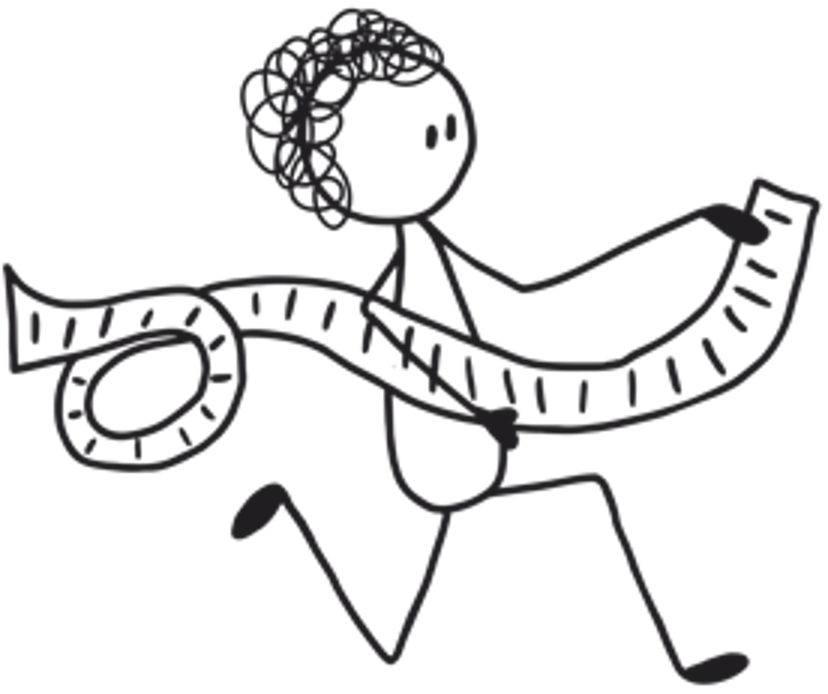

Your First Reach-Out
  “Hey, it’s ___ with eXp.”
  “I know you’re probably happy at your current brokerage…”
  “I just wanted to let you know—if anything changes, we’d love to be your destination… your Plan B.”
Tom Truong
(617) 312-0838
TeamTruong@eXpRealty.com AgentsGetFree.com
  Soft, no-pressure approach designed to build familiarity

Slide 4

The 30-Minute Business Conversation
  “Let’s sit down for 30 minutes and have a conversation about your business.”
  Simple, clear, and business-focused
  Invite framed as value-driven, not a recruitment pitch
  Goal: Identify pain points, goals, and opportunities
Tom Truong
(617) 312-0838
TeamTruong@eXpRealty.com AgentsGetFree.com

Slide 5

Objection Handler 1: Open-Mindedness
“Are you open-minded about your business?”
  A low-pressure question that encourages reflection
  Moves the conversation from resistance to curiosity
  Helps identify whether they’re receptive to new opportunities
Tom Truong
(617) 312-0838
TeamTruong@eXpRealty.com AgentsGetFree.com

Slide 6


Objection Handler 2: Big Thinker Mindset
“Are you a big thinker or a little thinker?”
  Encourages them to self-identify as growth-oriented
  Nudges them away from limiting beliefs
  Creates alignment with expansion and opportunity

Slide 7

Objection Handler 3: Competitive Advantage
“I don’t know… I always thought it made sense to sit with the competition and see what they’re doing.”
“Don’t you agree?”
  Reframes the conversation as a smart business move
  Removes the stigma around exploring other brokerages

Slide 8




Thank you!
Tom Truong
(617) 312-0838
TeamTruong@eXpRealty.com AgentsGetFree.com

