Slide 1




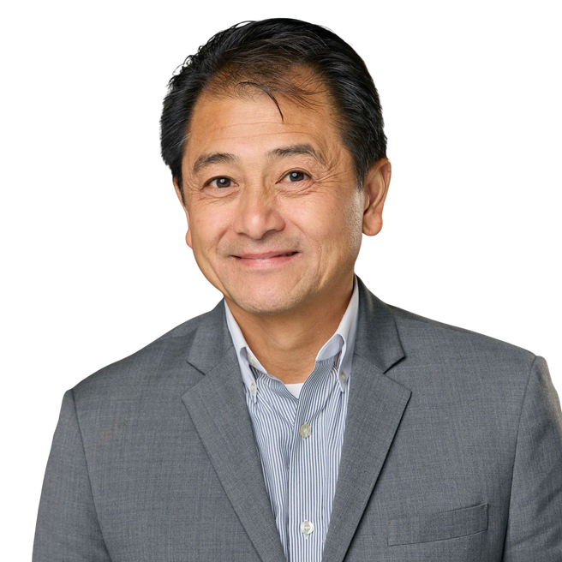

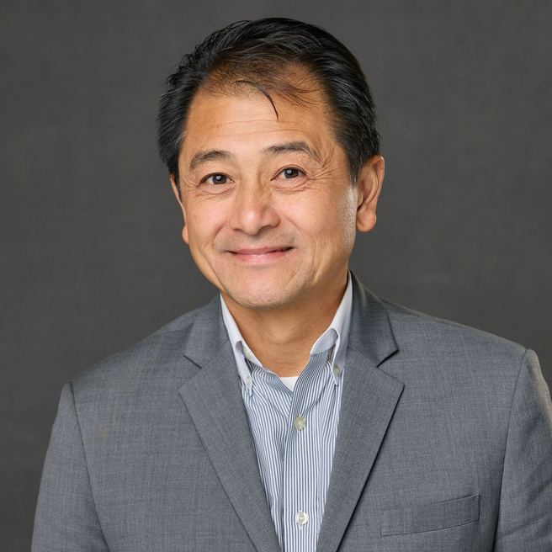
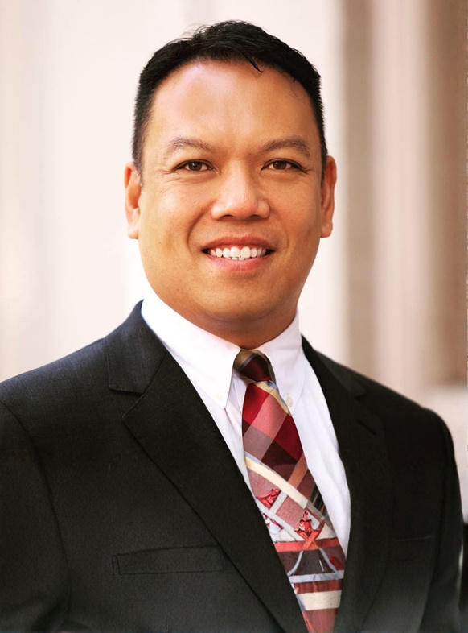
LET’S GET
LET’S GET
GROWING!
GROWING
ATTRACT AGENTS & GET FREE LEADS
140 Woodland Rd, Southborough, MA 01772
December 3, 2025
10 AM - 3PM
Ticket Price: $19
Learn simple, proven strategies to attract quality agents and expand your network. Plus, get free qualified leads to jump-start your growth and elevate your business!
Tom Truong
Dick Lee

Slide 2



AGENT ATTRACTION
CALLS, MEETINGS & FOLLOW-UPS
Presented by: Tom Truong

Slide 3

THE GOLDEN RULE OF
AGENT ATTRACTION
SAY LESS. ASK MORE. DISCOVER FIRST.
  You are not here to pitch — you are here to discover:
  Their goals
  Their pain points
  Their frustrations
  What they wish their brokerage provided / what’s lacking
  What they want to achieve in the next 12 months
If you jump into the EXP pitch too early, you lose the call.

Slide 4

  “What’s your focus in your business right now?”
  “What do you want your business to look like in the next 12 months?”
  “What are the biggest challenges holding you back from that?”
  “If you could change ONE thing in your current brokerage, what would it be?”
  “If the right support and tools were in place, what would your ideal business look like a year from now?”
5 CORE DISCOVERY
QUESTIONS
Tip: The person asking the questions controls the conversation.

Slide 5

PAIN → PLEASURE → CURIOSITY FRAMEWORK
FIND THE PAIN:
PAINT THE PLEASURE:
SPARK CURIOSITY:
  Lack of support
  No leads
  Low commission splits
  No retirement plan / growth path
  Bad or no culture/community
  No training / accountability
Lead with the video and 3-way call
Curiosity is the gateway to the close
Ask: “What would doubling or tripling your income do for you?”

Slide 6

Use only after discovery
“Would you be open-minded enough to look at a global company that’s helping agents:
  Double and even triple their income
  Get national & international leads
  Earn stock ownership
  Keep up to 100%+ commissions
  Build long-term income even after retirement
  Would any of that interest you?”
THE EXP
OPENER

Slide 7

STEP 1: ASK PERMISSION
“Great — I’ll send you a short 7–9 minute video.”
VIDEO + FOLLOW-UP FLOW
STEP 2: TIME-LOCK
“If I send it now, when can you watch it?”
STEP 3: SCHEDULE THE FOLLOW-UP
“Perfect — let’s schedule a quick follow-up with me and XXX after you watch.
Would ___ or ___ work for you?”
TIP: NEVER END THE CALL WITHOUT A FOLLOW-UP BOOKED.

Slide 8

OBJECTION
HANDLING
  “I need a local office.” → “How often do you go now?” + Regus access
  “eXp is a pyramid scheme.” → “What makes you feel that way?” + explain Corporation/NASDAQ
  “I’m not tech savvy.” → Only MLS, SkySlope & Slack required
  “I’m loyal / my broker is family.” → “Aside from loyalty, is there anything you wish you had more of?”

Slide 9

THE 3 MOST POWERFUL PHRASES
  “What makes you say that?” → gently breaks objections
  “Tell me more.” → encourages them to open up
  “Out of curiosity…” → softens every question and lowers resistance

Slide 10

RED FLAGS
(KNOW WHEN TO SAY NEXT)
  Need in-person office daily
  Extreme tech resistance
  Never available / non-committal
  Only interested in splits (not growth)
  Toxic, negative, or unwilling to learn
Focus on agents who want: Leads, support, growth, systems, mentorship, income streams, exit strategy

Slide 11

Studio Shodwe
FOLLOW-UP CADENCE
After Video:
Day 1: “Let me know your thoughts after you watch!”
Day 2: “Did you get a chance to check it out?”
Day 3: Send a value piece (training invite, success story, resource)
Day 5: Call / VM / text
Weekly:
Check in with value — offer knowledge, not pressure
Consistency beats persuasion

Slide 12
STEP 1: LEARN WHY THEY LEFT
“I’d really love to learn from your experience — what made you leave?”
FORMER EXP AGENTS
STEP 2: VALIDATE
“That makes total sense. A lot of agents felt that way before the updates.”
STEP 3: RE-OPEN THE DOOR
“If I could show you what’s different now, would you be open to taking a fresh 10-minute look?”

Slide 13
THANK YOU!
PRESENTED BY: TOM TRUONG

